Slide 1
Fundamentals of Probability for ML
Introduction to Deep Learning
Module 1, Class 6

Slide 2
Pre-read
Khan Academy — Probability & Statistics unit (covers PMF, PDF, expectation, variance) (Unit 7,8,9)
Normal Distributions
Poisson Distribution
CS 231n: Section on Softmax
Youtube: Correlation and Covariance
CS 231n: Section on Softmax

Slide 3
Agenda
Why ML needs probability
Random variables – discrete vs continuous
Expectation & Variance
Joint & Conditional probability + Bayes’ rule
Covariance / Correlation / Independence
Estimating distribution parameters: API Response time example
Comparing distributions → KL divergence → Cross-entropy loss

Slide 4
Motivation
Probabilities and probability distributions are used extensively in Deep Learning. Eg., a classification network outputs a probability distribution over classes, the dropout regularization method probabilistically removes neurons from a network, weights are initialized by sampling from a normal distribution..

Slide 5
Random Variables
A random variable is a variable whose value is a numerical outcome of a random phenomenon. A discrete random variable has a countable number of possible values, such as the number of heads in three coin flips. A continuous random variable can take on any value within a given range, meaning there are infinite possible values between any two given values, such as a person's height

Slide 6
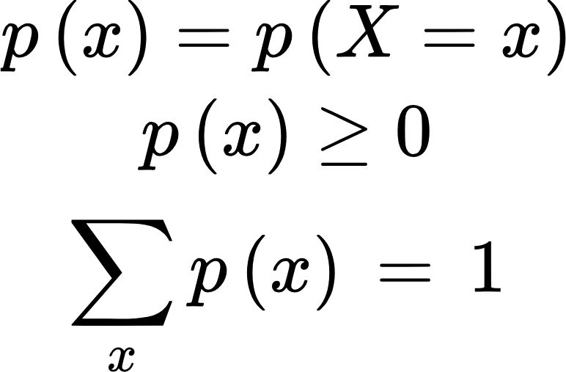
Discrete Random Variables
A discrete random variable is one that can take on a countable number of distinct values,
such as 0,1,2,3 or {−1,0,1}
It is described by a probability mass function (PMF):

Slide 7
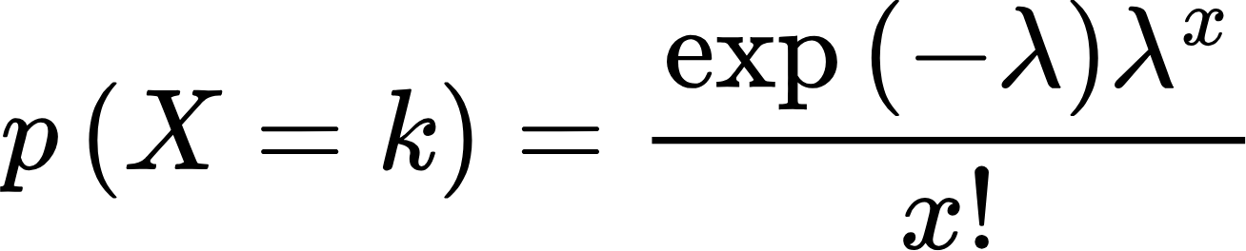
Discrete Random Variables
Random Variable | Values | PMF | Description
Coin toss | {0, 1} | p(1)=0.5, p(0)=0.5
Number of heads in 3 tosses | {0, 1, 2, 3} | Binomial distribution | Describes the number of "successes" in a fixed number of independent trials (n), where each trial has only two possible outcomes (success or failure). Prob(success) = p
Number of emails received per hour | {0, 1, 2, ...} | Poisson distribution | Models the probability of a specific number of independent events happening over a fixed interval (t), when you know the average rate of these events (lamda)

Slide 8
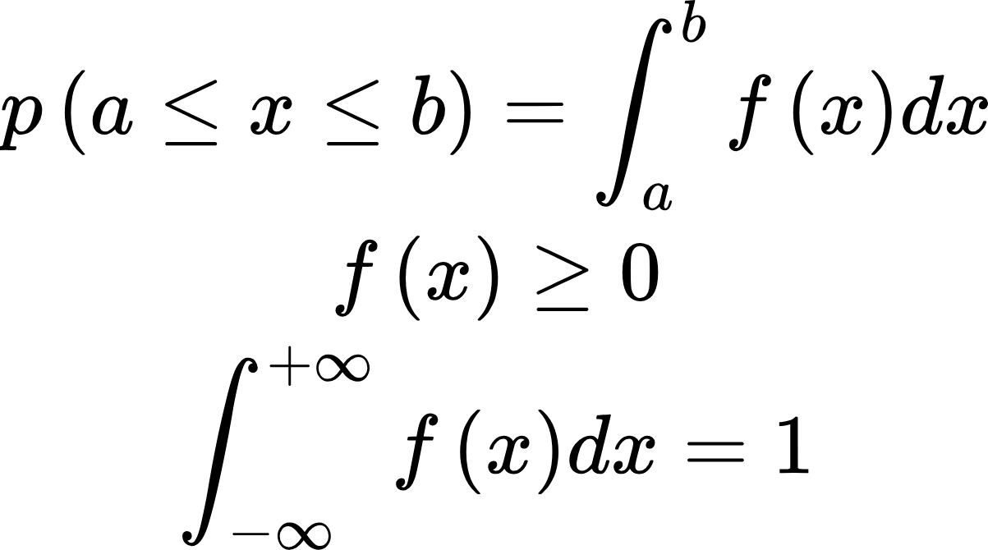
Continuous Random Variables
A continuous random variable takes values from an uncountable set — typically all real numbers in an interval.
We describe it using a probability density function (PDF) f(x) such that:
Intuition
The probability that X takes any single value (e.g., X=0.5) is zero.
Instead, we talk about the probability of a range of values.
The PDF is like a curve that shows how likely different regions are.

Slide 9

Continuous Random Variables
Random Variable | Range | PDF / Description
Height of a person | ( [0, ) ) | Approx. Normal(μ, σ²)
Time between phone calls | ( [0, ) ) | Exponential(λ)
Temperature of a city | ( (- , ) ) | Normal(μ, σ²)

Slide 10
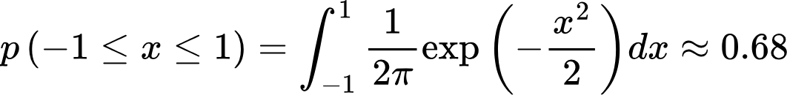
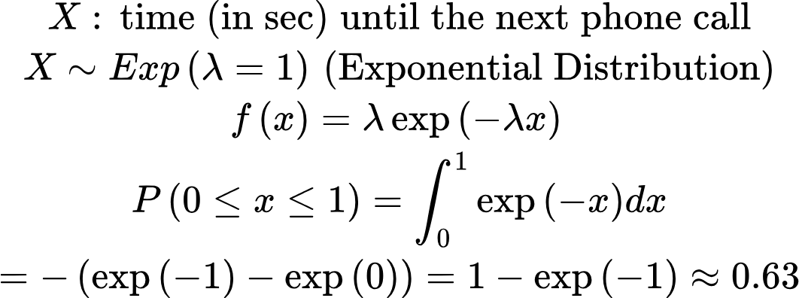
Examples

Slide 11
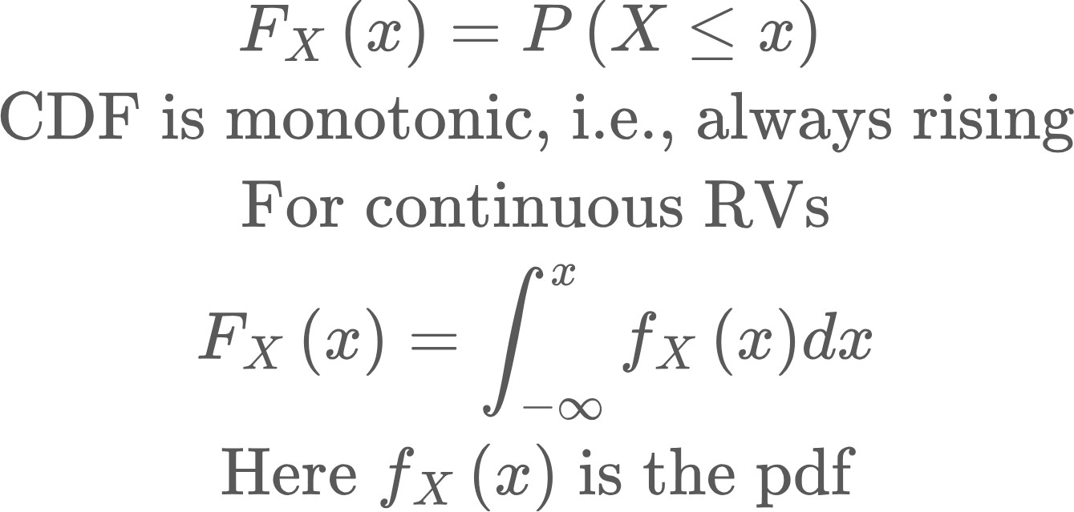
Cumulative Density Function
PDF asks the question--”what is the probability that X (say outcome of rolling a dice) = 4?”.
CDF asks the question--”what is the probability that X <= 4?

Slide 12
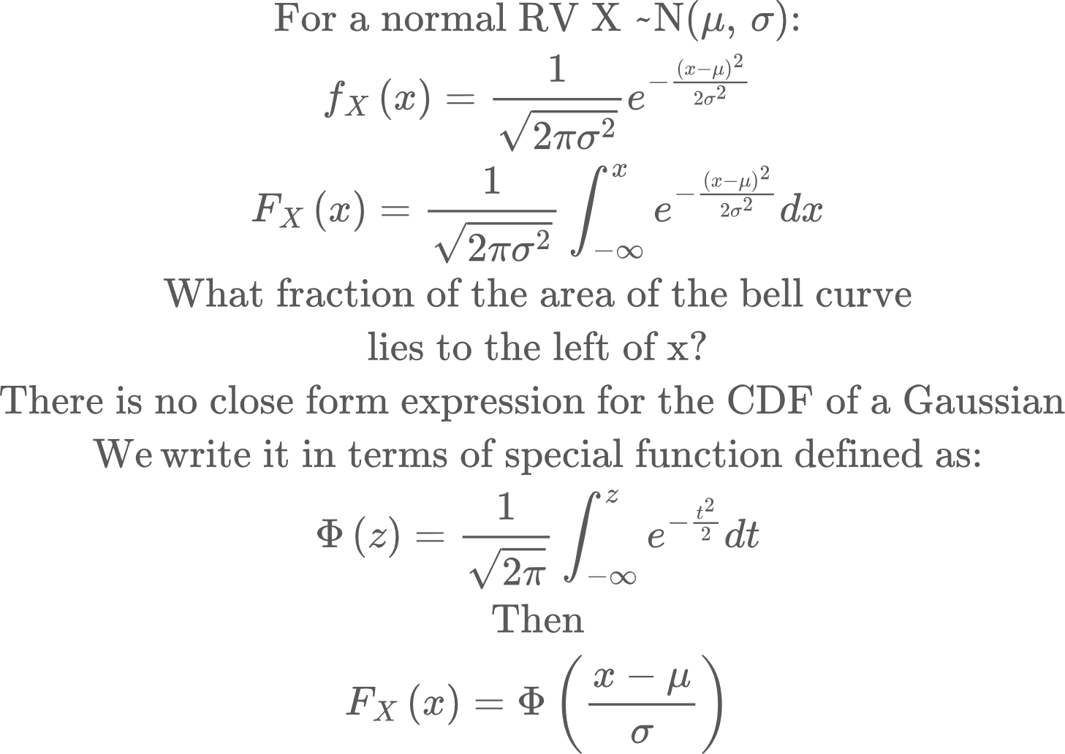
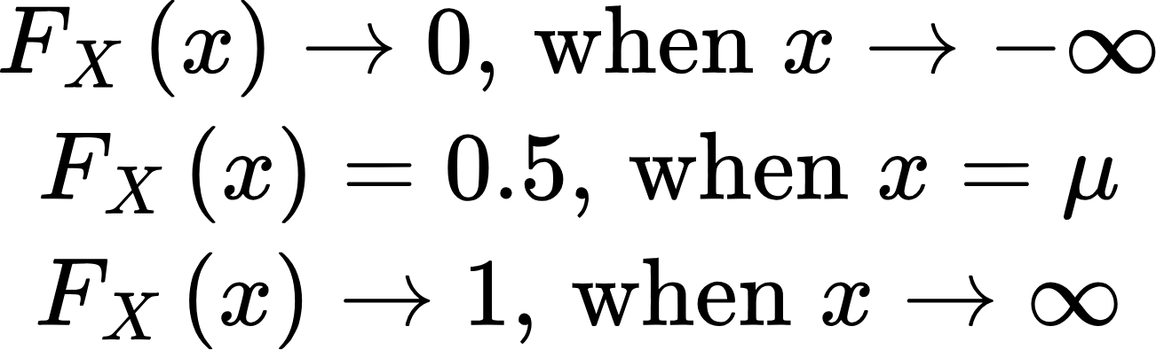
Cumulative Density Function: Gaussian RV
The concept of “percentile” is closely related to CDFs. If we denote the response times of an API call with a random variable x, then the pxx (eg., p99) of the API is the time t such that:

Slide 13
Expectation and Variance
Now that we know what random variables are — both discrete and continuous — we want to describe their average behavior and spread.
That’s what expectation (mean) and variance capture.
The expectation of a random variable X, denoted E[X], is the weighted average of all possible values of X, using their probabilities as weights.

Slide 14
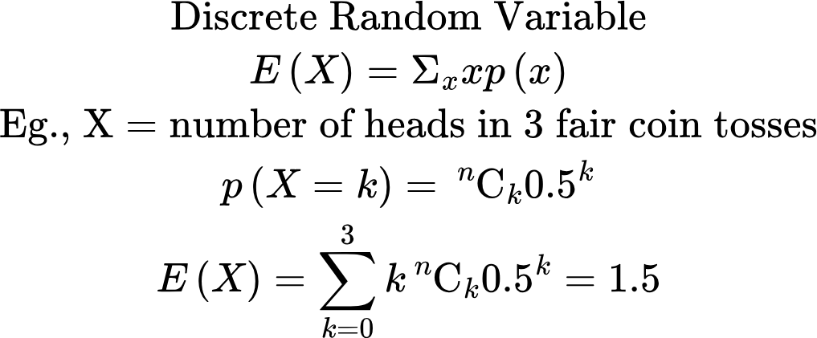
Expectation
Interpretation: If you repeat the 3-toss experiment many times, the average number of heads tends to 1.5.
Note: The average itself is not in the possible values of X!

Slide 15
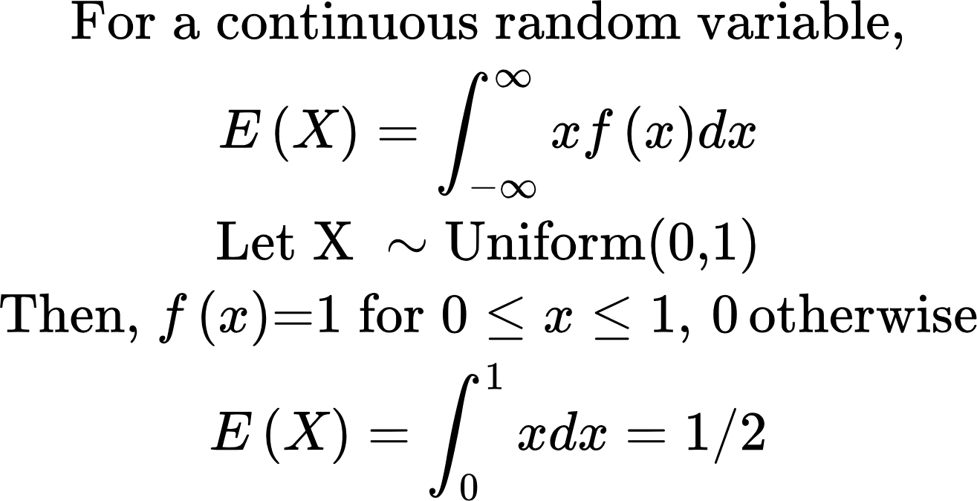
Expectation
For a uniform distribution between 0 and 1, the expected value (average) is right in the middle — 0.5

Slide 16
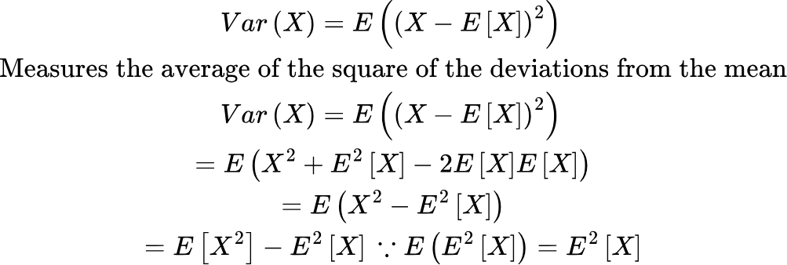
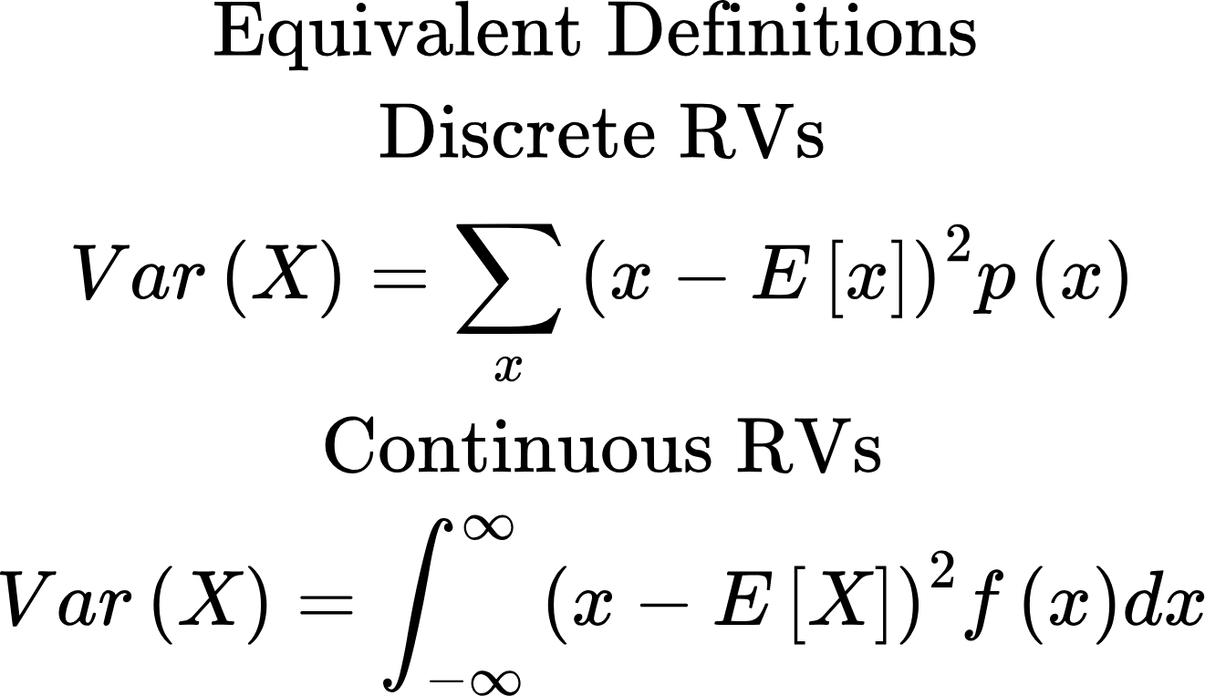
Variance
Expectation tells us the average value.
Variance tells us how far the values of X are from that average.

Slide 17
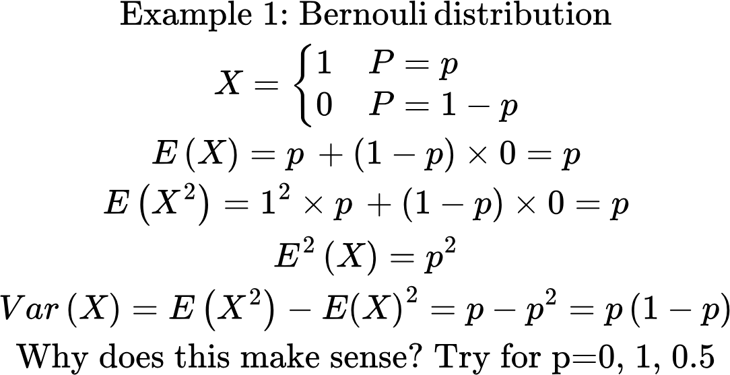
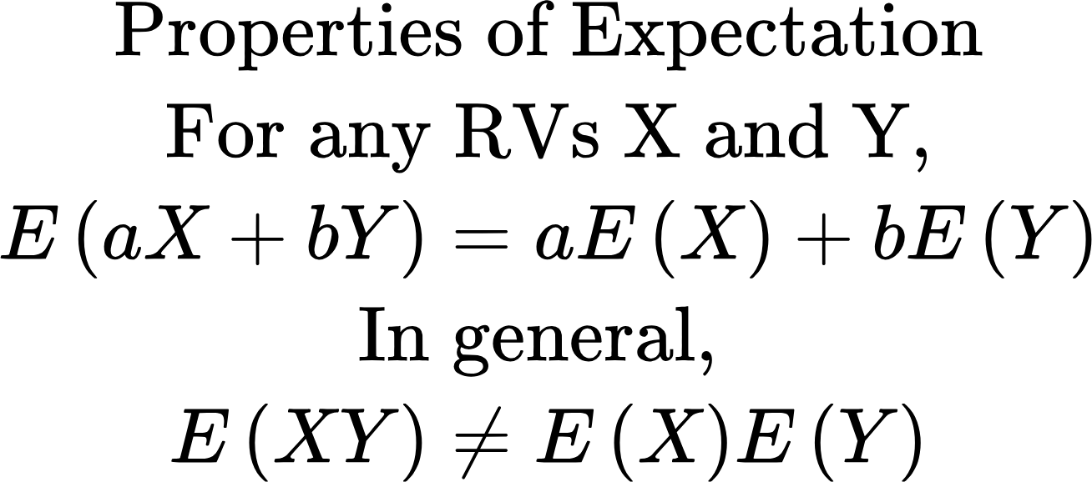
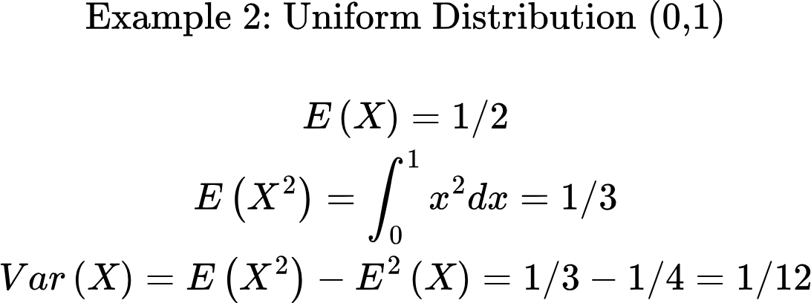
Examples

Slide 18
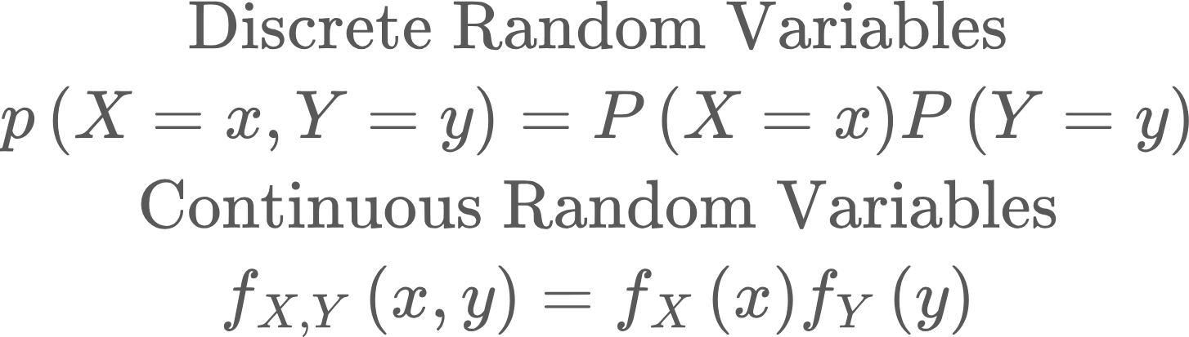
Joint Random Variables
Joint random variable means considering the probability distribution of multiple random variables together. When the RVs are independent, the pd of the joint RV factors into the product of the pds of the component RVs
Examples
Independent:
Two fair dice: P(Dice1 = 3, Dice2 = 5) = P(Dice1 = 3)P(Dice2 = 5) = 1/36
Rolling one die does not influence the outcome of the other.
Dependent:
X = number of heads in 2 tosses Y=1 if first toss is a head, 0 otherwise → X and Y are dependent because knowing Y changes the likely values of X.
See Part 2 in dice_roll.py

Slide 19
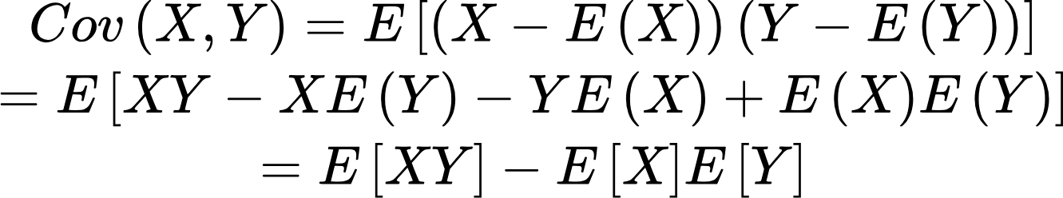
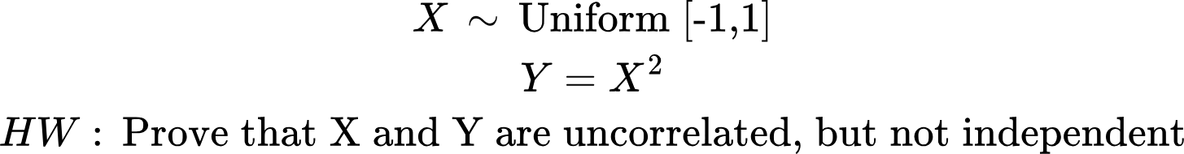
Covariance
Covariance measures how two random variables vary together
Cov(X,Y) > 0: when X increases, Y tends to increase (eg., height and weight)
Cov(X,Y) < 0: when X increases, Y tends to decrease (eg., altitude and temperature)
Cov(X,Y) = 0: no linear relationship (eg., # of code commits and developer productivity :-))
Independent RVs are uncorrelated, but reverse is not true!

Slide 20
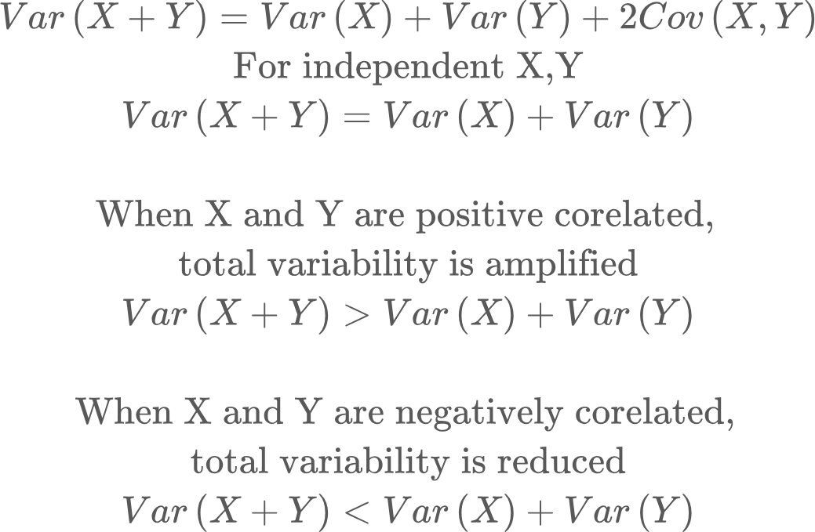
Properties of Variance
See Part 2 in dice_roll.py

Slide 21
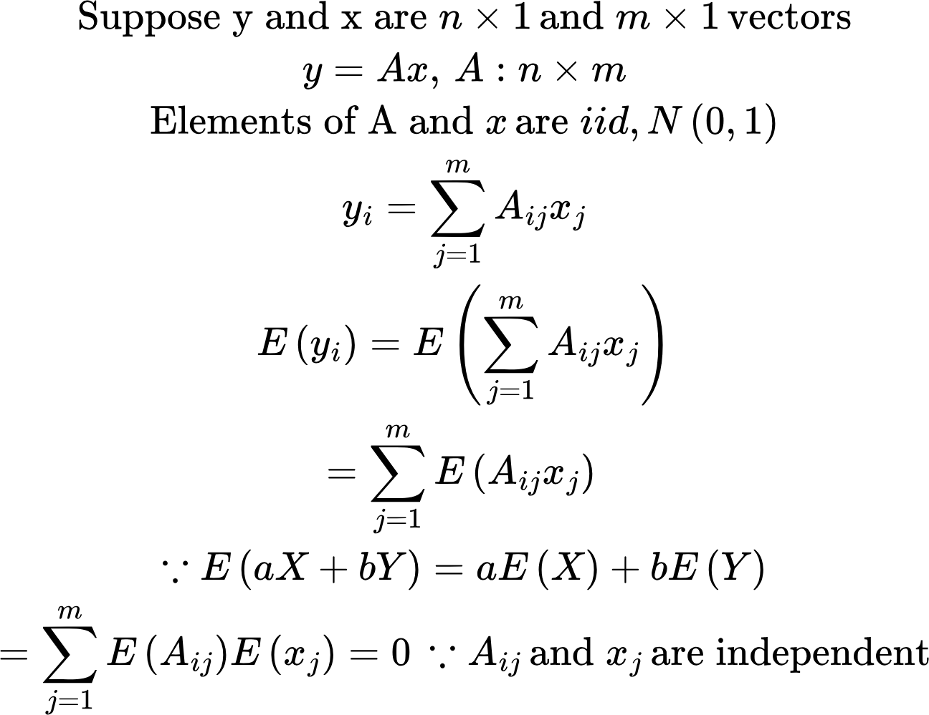
Properties of Variance: Matrix Product
See variance_analysis_no_bias.py

Slide 22
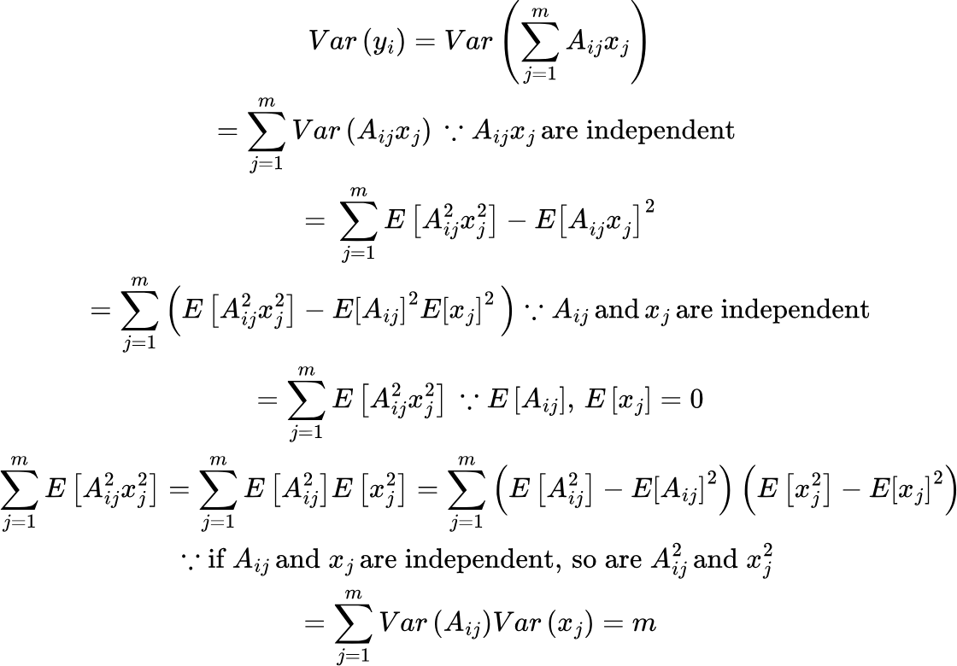
Properties of Variance: Matrix Product
See variance_analysis_no_bias.py

Slide 23
Joint and Conditional Probabilities
Joint Probability: Probability that both events occur p(A,B) = p(A and B both occur)
Conditional Probability: p(A|B) = p(A, given that B has occurred)
Eg., Let A: “email contains the word lottery”
and B: “email is spam.”
If P(A,B)=0.06 and P(B)=0.1
then P(A∣B)=P(A,B)/p(B) = 0.06/0.1=0.6.

Slide 24
Joint and Conditional Probabilities
If A and B are independent, p(A|B)=p(A). Intuition: B doesn’t provide any information about A
Bayes Theorem: p(A|B) = p(B|A)p(A)/p(B)
Example:
p(T+) = p(T+|D+)p(D+) + p(T+|D-)p(D-) = 0.99*0.01 + 0.05*(1-0.01) = 0.059
What is the probability that I’m diseased, if the test is positive?
p(D+|T+) = p(T+|D+) p(D+) / p(T+) = 0.99 * 0.01/0.059 = 0.167!
Event | Probability
Disease (D+) | 0.01
Positive Test (T+ if diseased) | 0.99
Positive Test (T+ if healthy) | 0.05

Slide 25
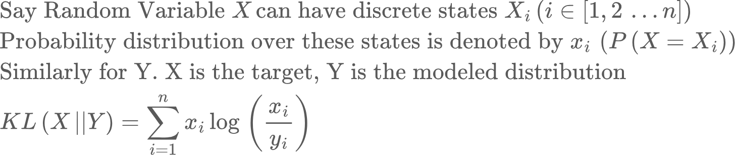
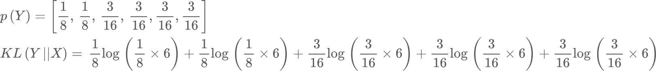
Comparing two probability distributions
Say we have two dice. One is a balanced dice (X), so the probability of rolling numbers 1-6 is ⅙. The second (Y) is unbalanced, with the following distribution
=0.016.
Note: KL(X||Y) = 0.017! KL(X||Y) doesn’t equal KL(Y||X)! I.e., KL distance isn’t symmetric!

Slide 26
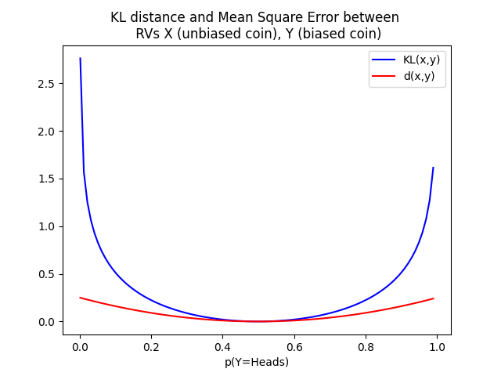
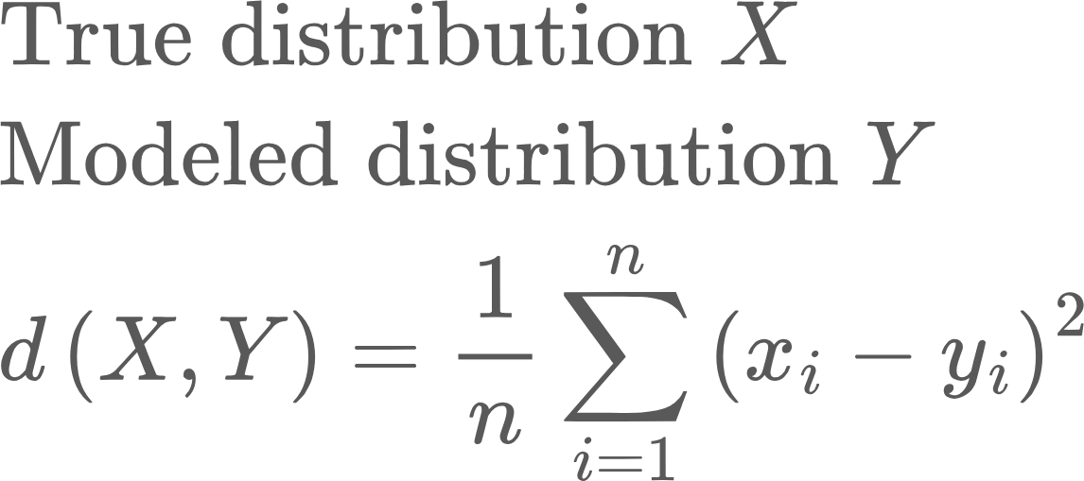
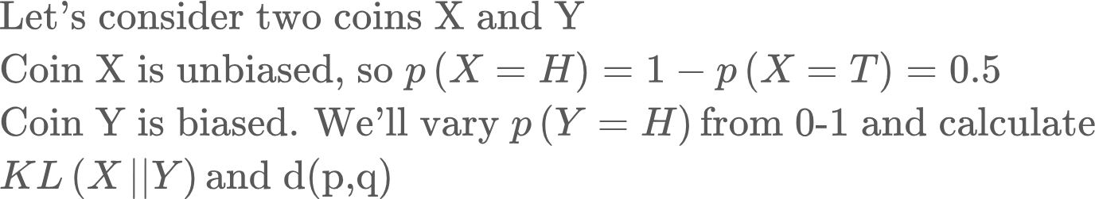
Comparing two probability distributions: KL vs MSE
Why not just use Mean Square Error?
Notice that KL distance penalizes large deviations between p(X) and p(Y) much more severely!
Also, when p(Y) assigns a 0 probability to an outcome that p(X) assigns a non-zero probability, KL distance blows up, while MSE doesn’t

Slide 27
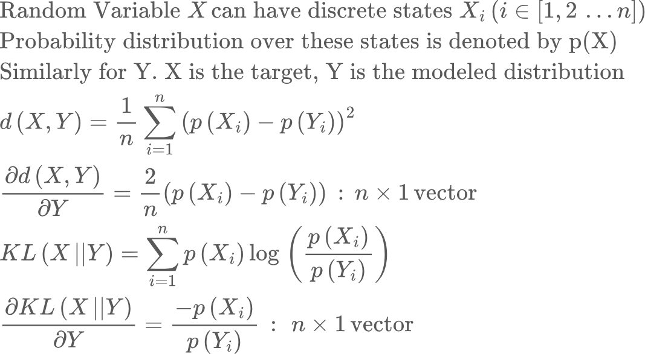
Comparing two probability distributions: KL vs MSE
Why not just use Mean Square Error?
Let’s consider the gradient wrt Y
The gradient of the KL distance is much larger when p(X) and p(Y) differ a lot. This results in faster convergence. More on this later..

Slide 28

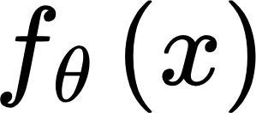
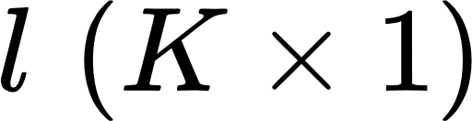
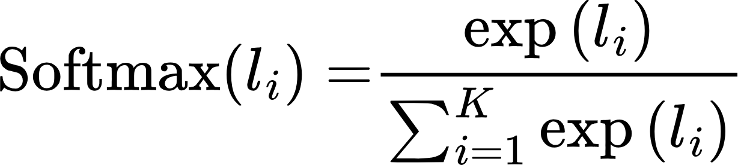
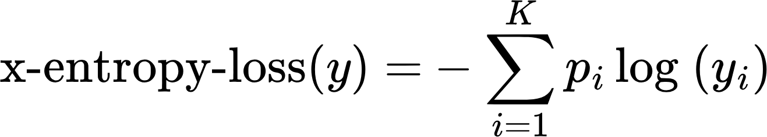
Cross Entropy Loss
For classification problems, we need to compare two probability distributions--the network output and ground truth distribution. This is done using cross entropy loss
First we need to convert network output into probabilities. This is done using a Softmax function. Say we have input x into a network characterized by parameters theta. The output can be one of K classes
convert logits into probabilities
l
(logits)
y
class probabilities
Softmax
Cross-entropy loss
True probability distribution (p)
Why does this expression make sense?
Usually p is a one-hot vector. It is 1 for the input’s true class, and 0 everywhere else.

Slide 29
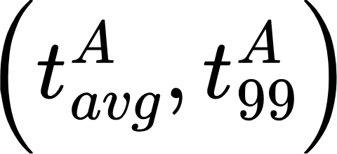
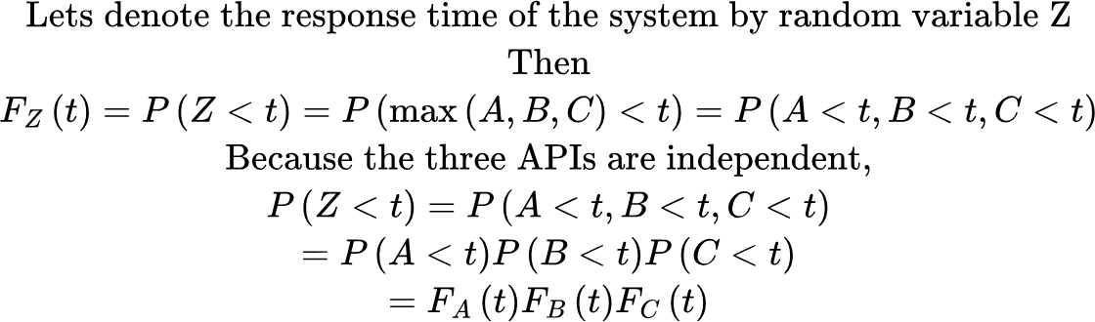
Cumulative Density Function: API Calling--”wait for all”
I have three independent APIs, A, B, C, with average and p99 response times:
A system (Z) calls these APIs at the same time and waits for the slowest API to return (“wait for all”). How do we calculate the p99 of this system’s response time?

Slide 30
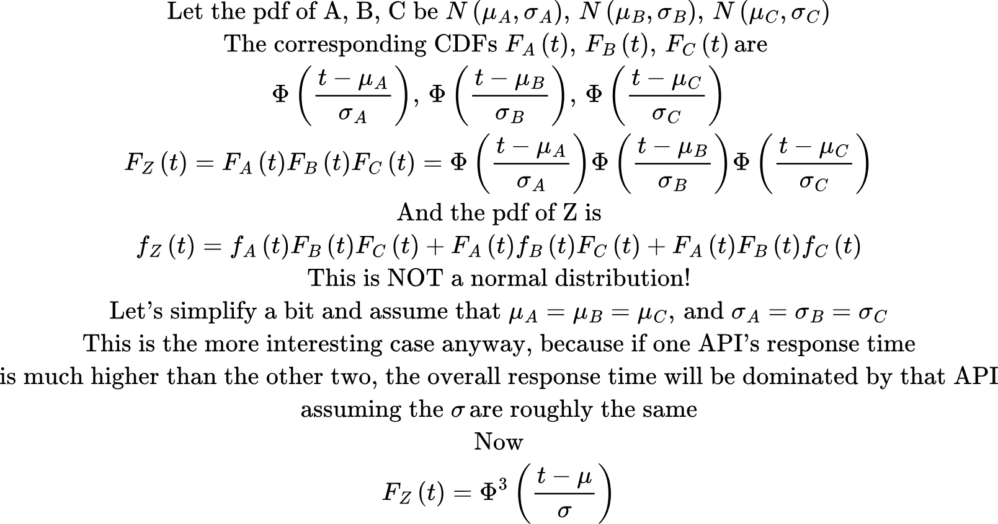
Cumulative Density Function: API Calling--”wait for all”

Slide 31
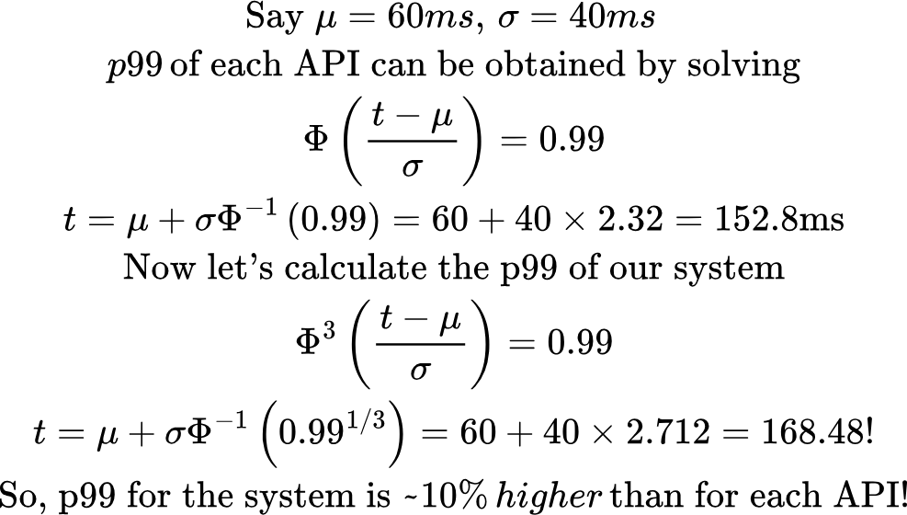
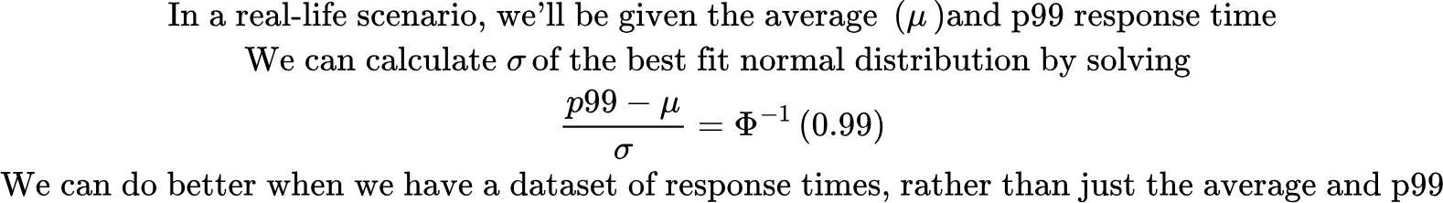
Cumulative Density Function: API Calling--”wait for all”
API_call_wait_for_all.py

Slide 32
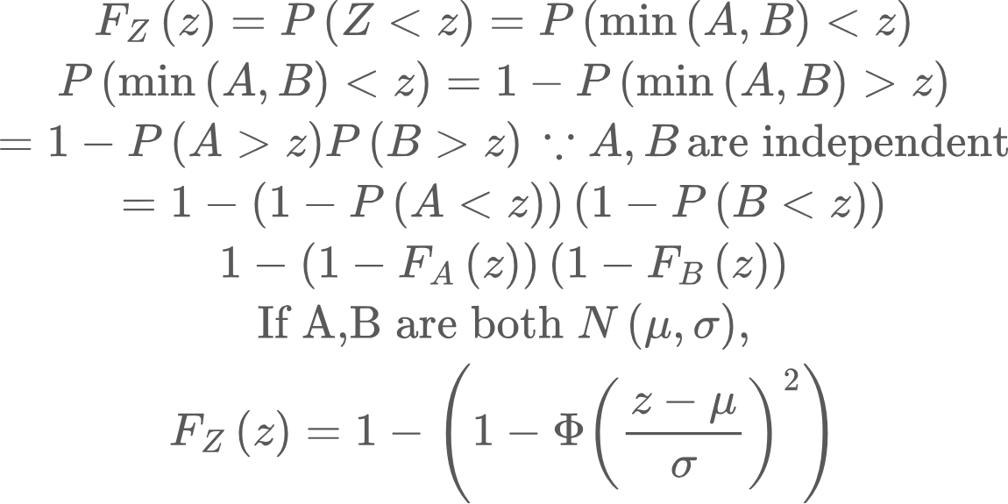
Cumulative Density Function: API Calling--”race to first”
Now let’s say the system goes by the response of whichever API returns first, rather than waiting for the slowest. To simplify things a bit, let’s just consider two APIs. Now Z=min(A,B)

Slide 33
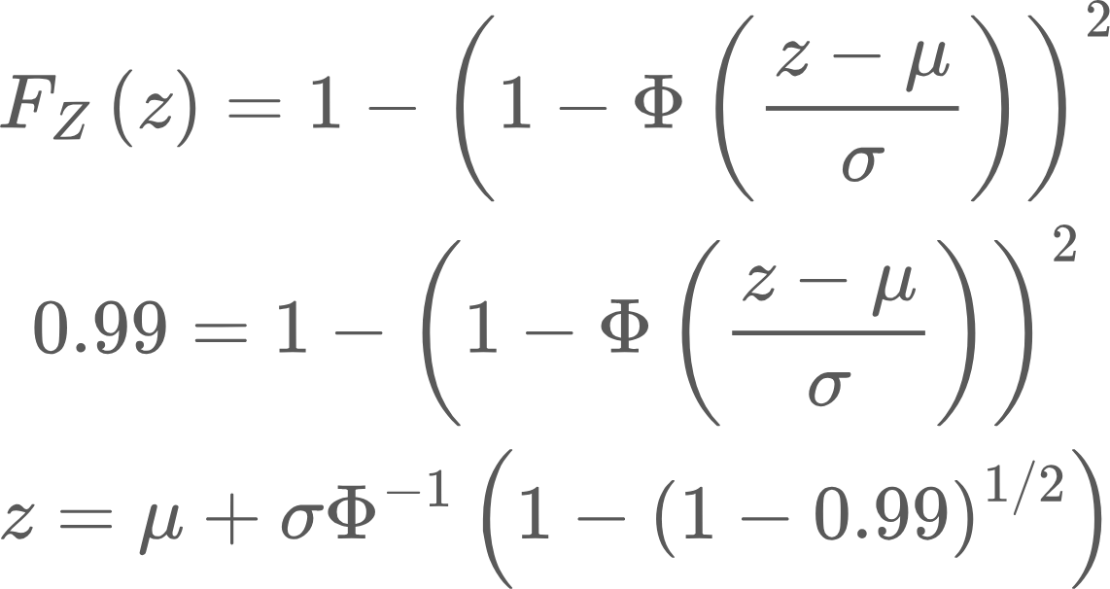
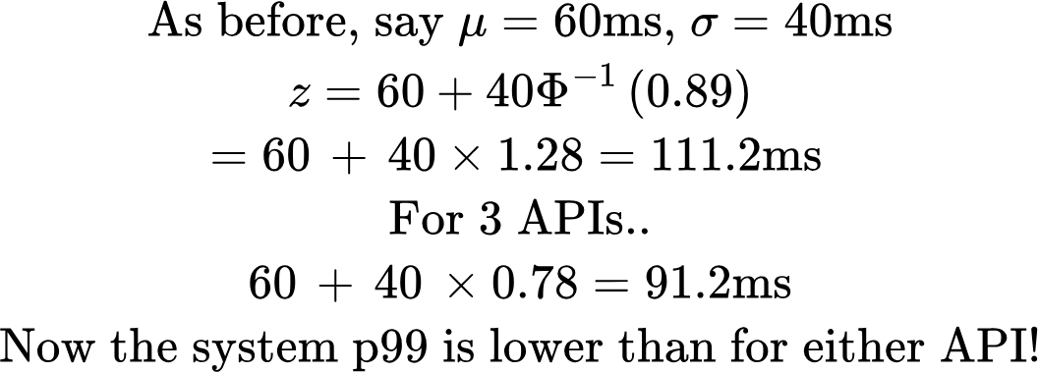
Cumulative Density Function: API Calling--”race to first”
Let’s solve for the 99th percentile..
API_call_race_to_first.py

Slide 34
Modeling API response times..
Given a dataset of API responses, I can pose two questions:
How do I determine the parameters of a best fitting model?
Given a model, how do I determine the goodness of the fit

Slide 35
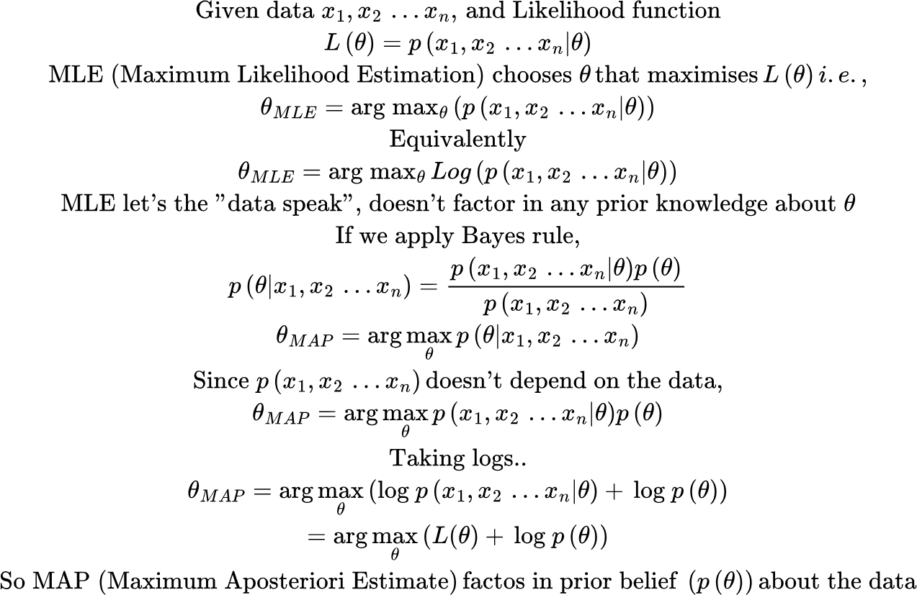
Determining model parameters: MLE vs MAP estimation

Slide 36
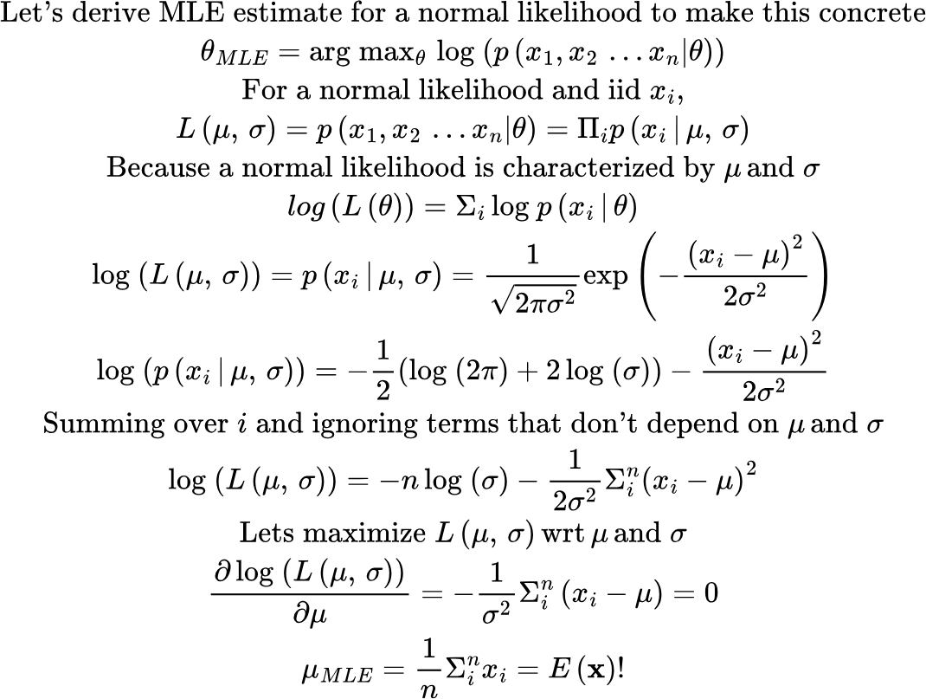
Determining model parameters: MLE
HW problem: Derive the MLE estimate of sigma

Slide 37
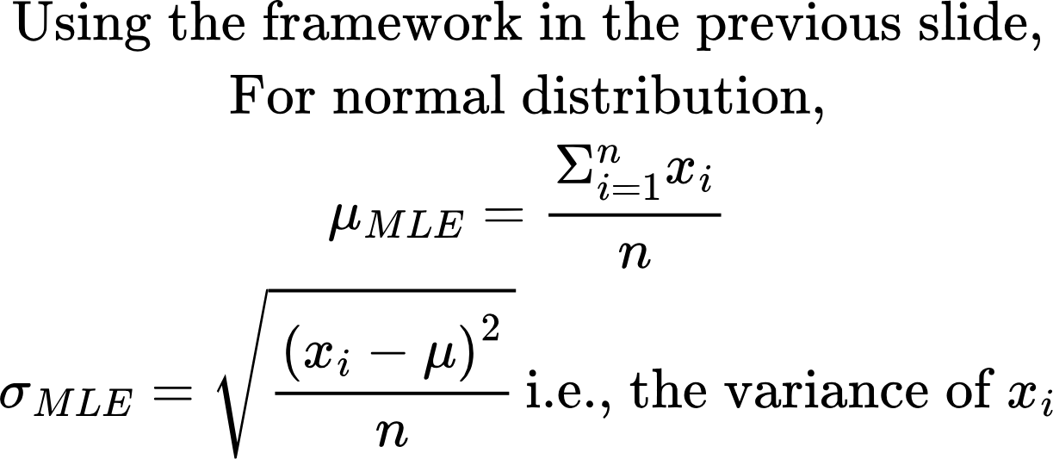
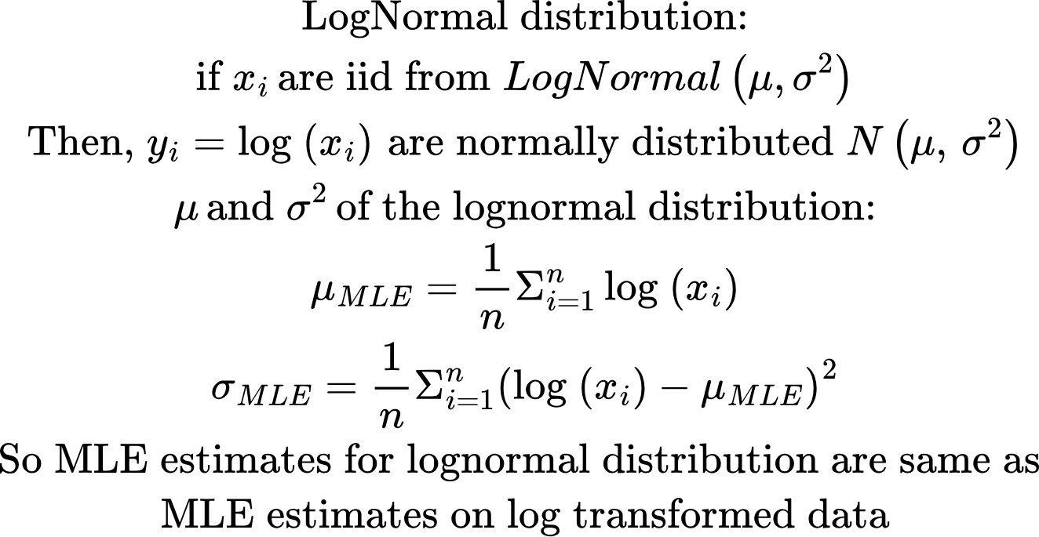
Determining model parameters: MLE

Slide 38
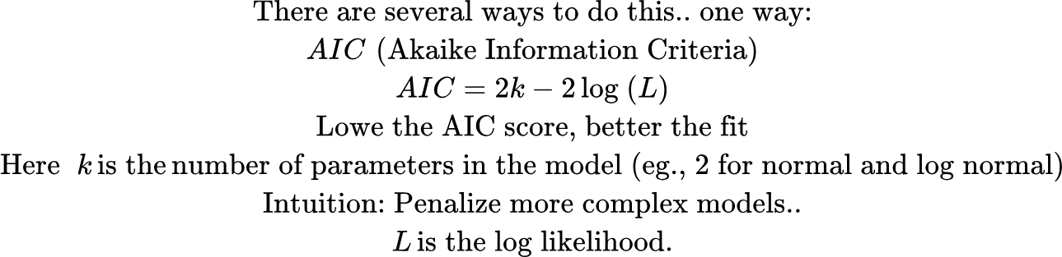
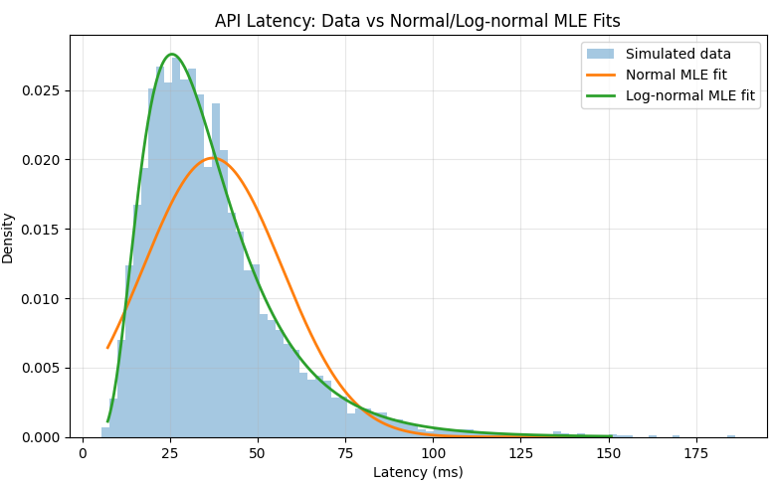
Determining goodness of fit
Visually lognorm is a better fit
Norm assigns lower probabilities to the long right tail, resulting in a lot of large negatives in the likelihood
See: parameter_estimation.py

Slide 39
Cross Entropy Loss
Let’s consider a binary classification example. Here K = 2
Let’s say p_1 = 1. If the network gets it right, y_1 is close to 1, and x-entropy loss is low. Similarly if the network gets it wrong, y_1 is low, and x-entropy loss is high.
To use it within a Neural Network, we need to calculate its derivative!

Slide 40

Cross Entropy Loss: Simple Example
Let’s say we have an image classification problem, with three classes--Cat, Dog, Horse. Our input data is image of a cat.
Predicted probability distribution y
True probability distribution p
Logits
Cat
0.24
0.09
0.66
1
0
0
-1
-2
0
Dog
Softmax
Cross-entropy loss
Horse

Slide 41
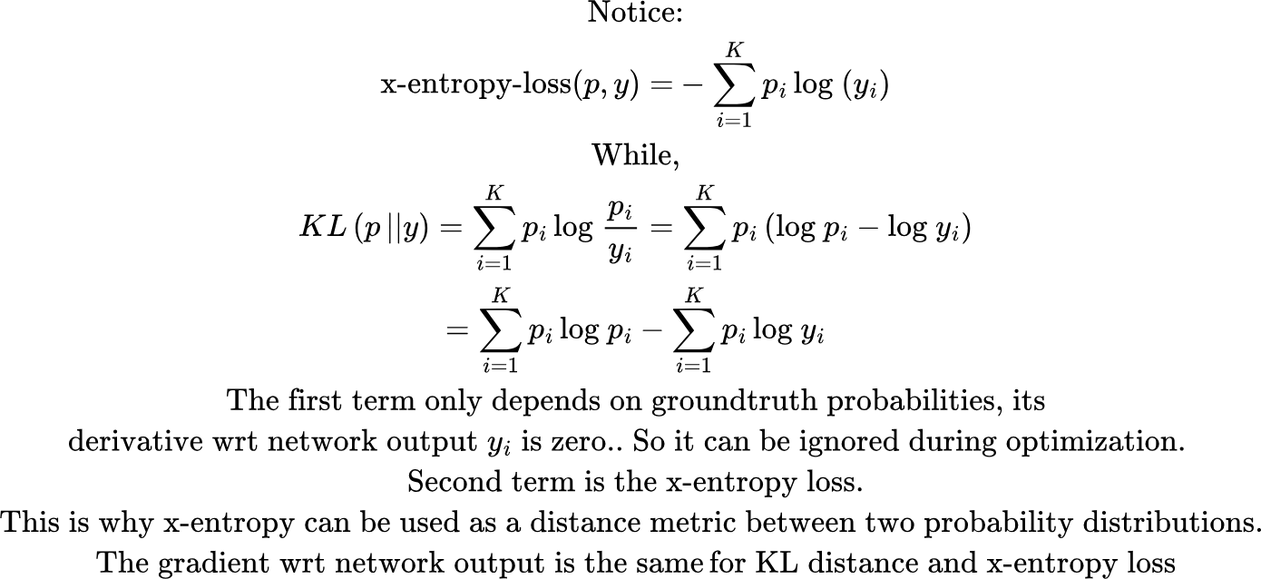
But cross-entropy loss isn’t the same as KL Distance!

Slide 42
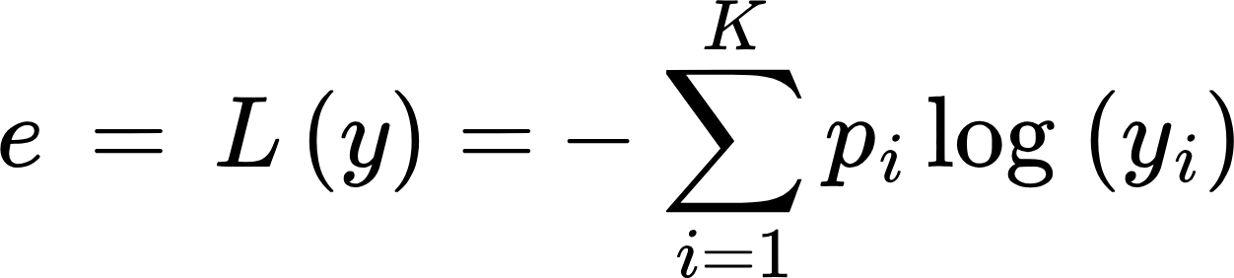
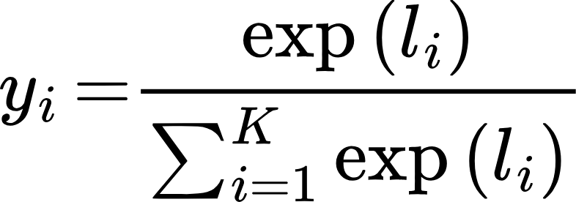
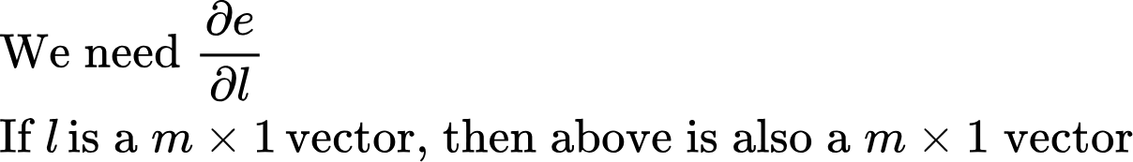
Cross Entropy Loss: Derivative
To use x-entropy loss in a neural network, we’ll need the derivative of its output against the input.
Let’s now derive the partial of e against partial of l using basic math

Slide 43
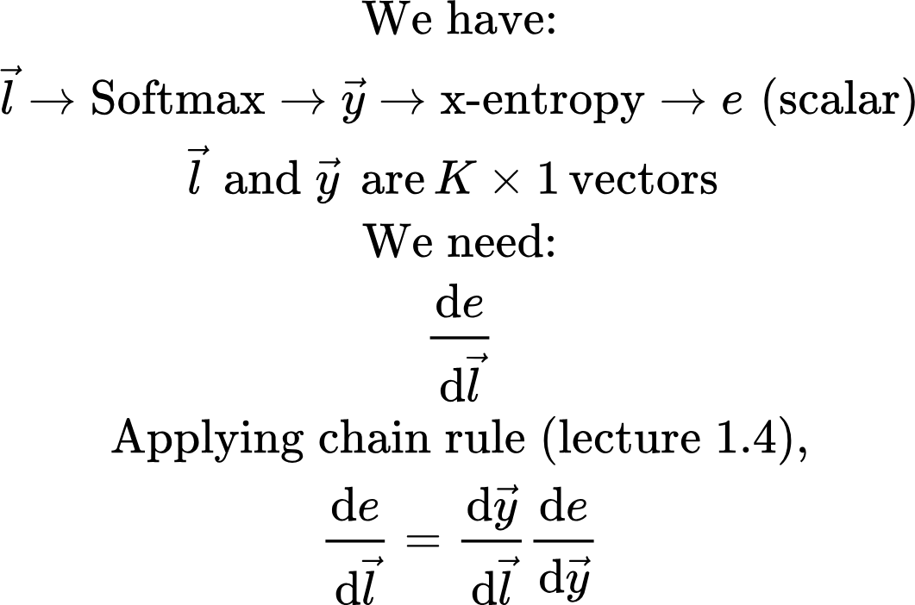

Cross Entropy Loss: Derivative

Slide 44
Homework
Run dice_roll.py and make sure you follow the logic
Following kl_distance.py, generate two discrete probability distributions A and B, and calculate KL distance KL(A,B) and KL(B,A). Verify they are not equal.
Prove all the math in the derivative of cross-entropy loss
Derive the MLE estimate of sigma in the derivation of MLE estimates of normal distribution
Read about Kolmogorov-Smirnov test, another method to compare two probability distributions

Slide 45
Appendix

Slide 46

Cross Entropy Loss: Derivative

Slide 47

Cross Entropy Loss: Derivative

Slide 48


Derivative of Softmax followed by MSE
Notice that multiplicative factor of y.. This results in a small gradient when model assigns a small probability to the correct class, slowing down convergence!
Ignoring the factor of 2/3

